Slide 1

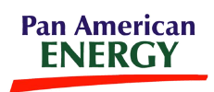

Completion and Wellbore Geomechanics in High Stress Settings
Jonathan McKenna, PhD
Orlando Teran
Ruth Ehlich

Slide 2
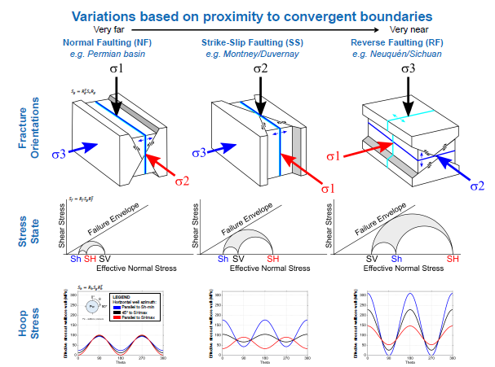
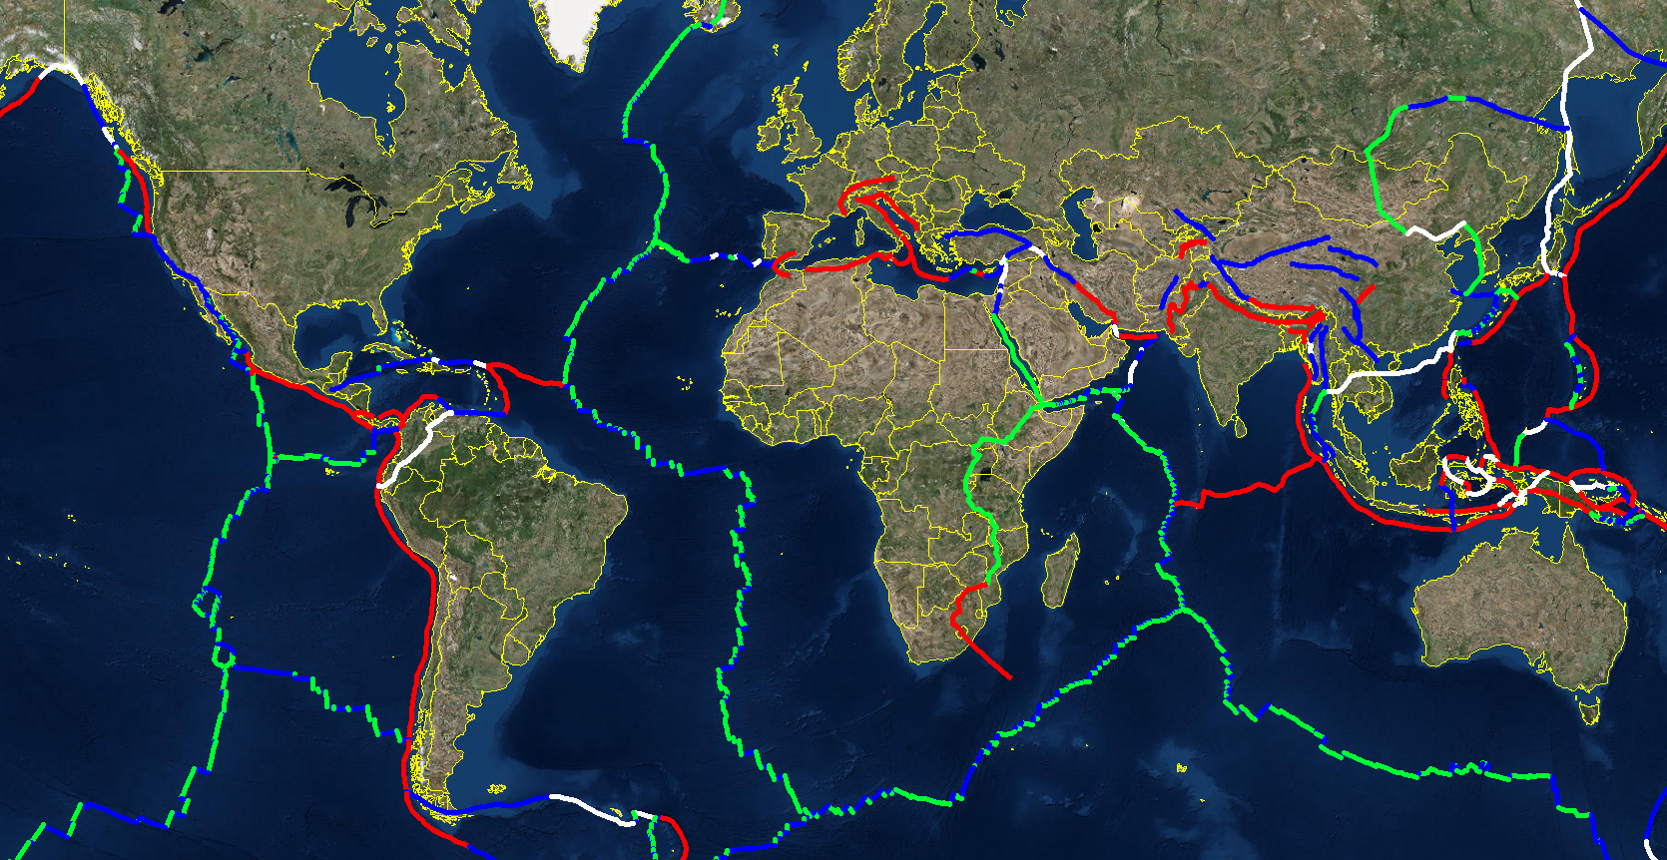

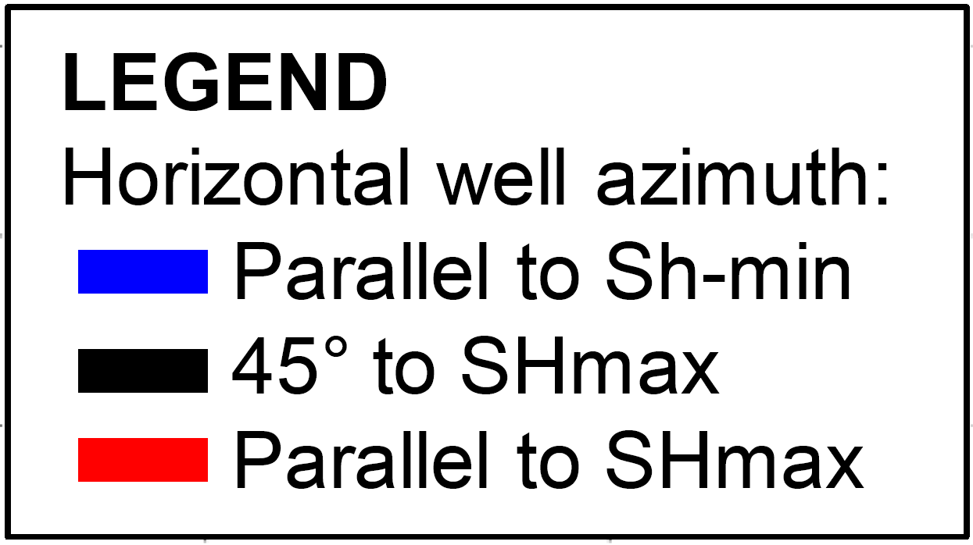

Global Tectonics and Wellbore Design
Proximity to convergent plate boundaries can be one of the most important factors controlling treatment design and wellbore stability
Divergent
Transform
Convergent

Slide 3
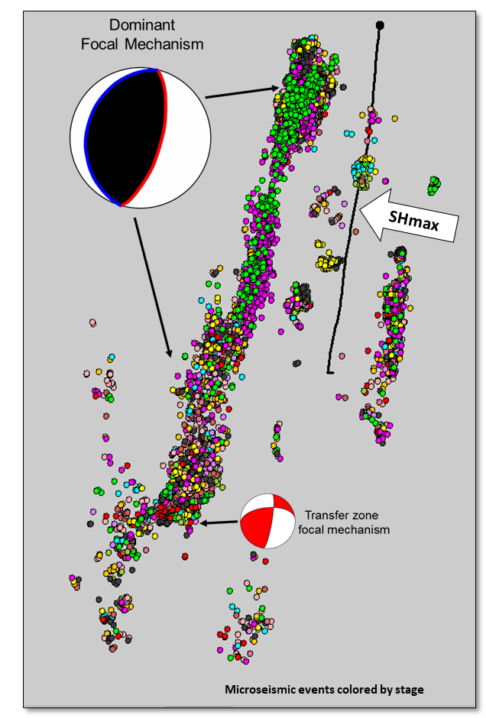
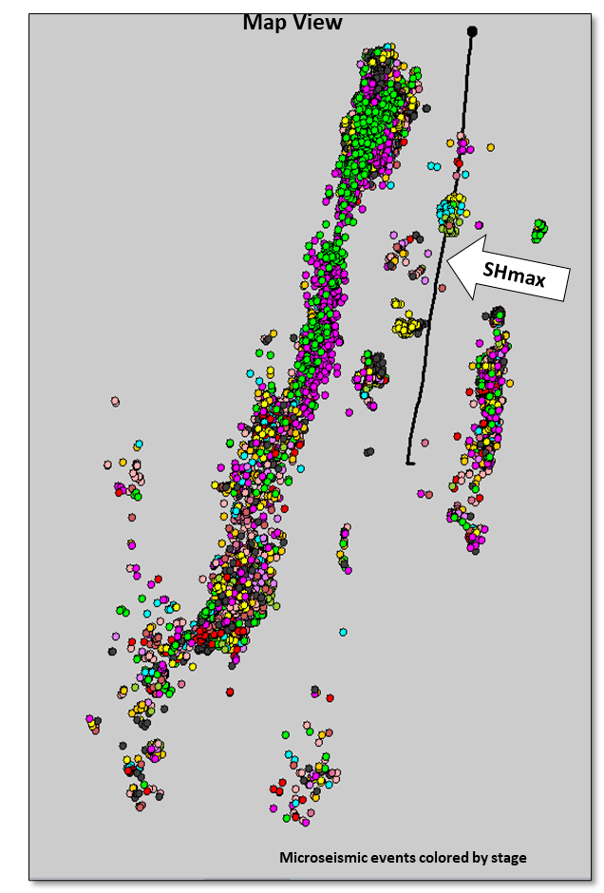
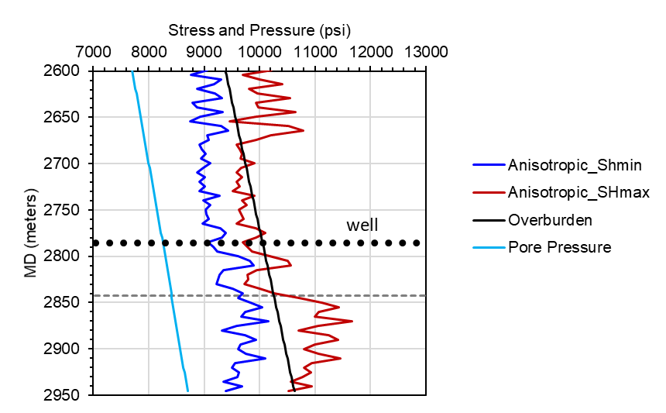

Microseismic Geomechanics – Vaca Muerta Example
Did not observe textbook “hydraulic fractures”; majority of stimulation reactivated large scale faults
Wells and completions were designed to “Texas standards”
Initial design based on normal faulting stress regime
Sonic log derived horizontal stress profiles

Slide 4
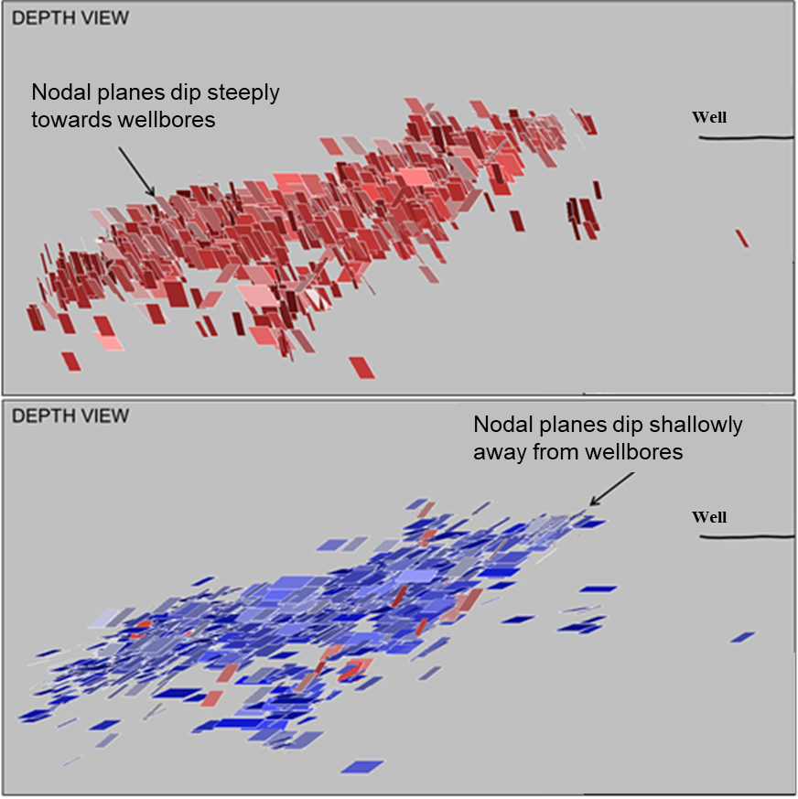
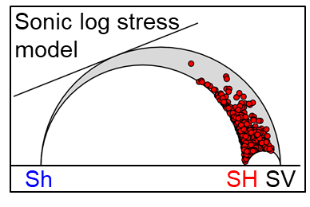
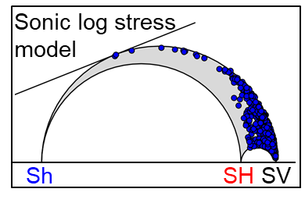

Microseismic Geomechanics – Identifying Failure Plane

Slide 5
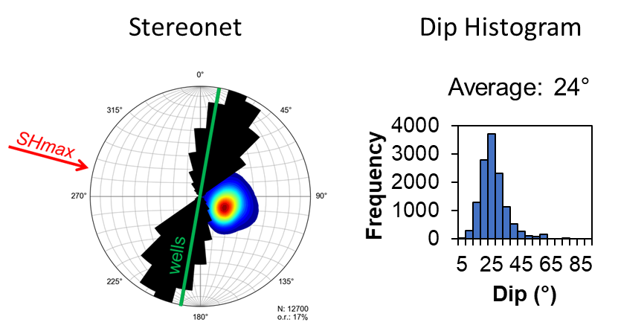

Microseismic Geomechanics – True Failure Plane

Slide 6
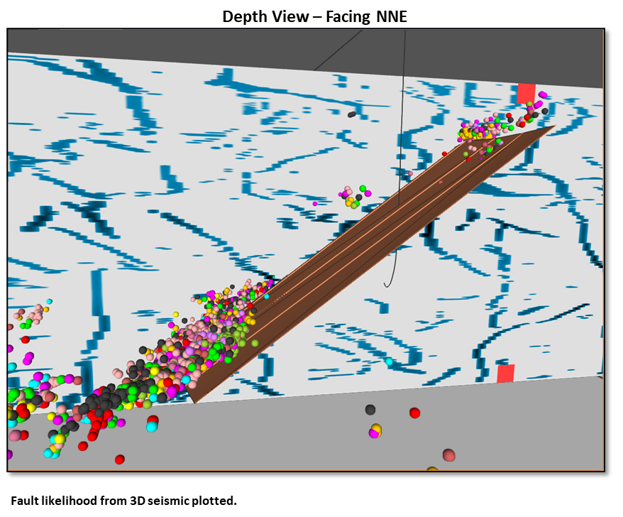

Fault Likelihood and Fault Plane

Slide 7
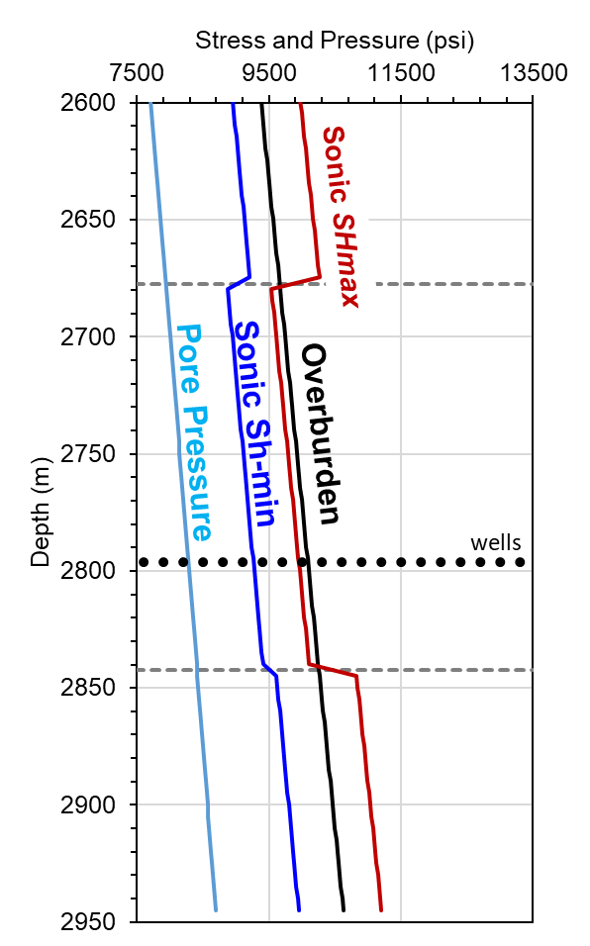
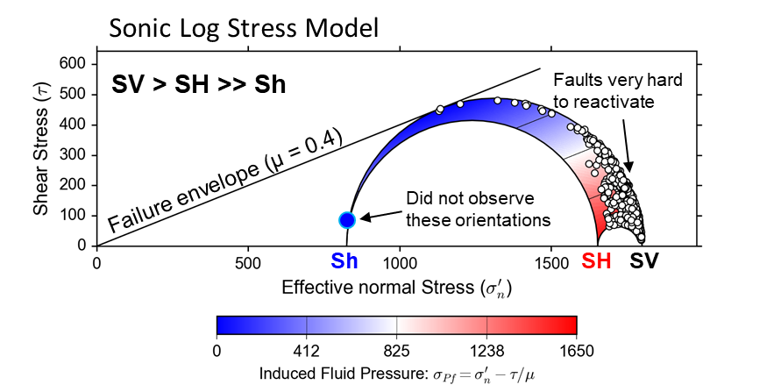
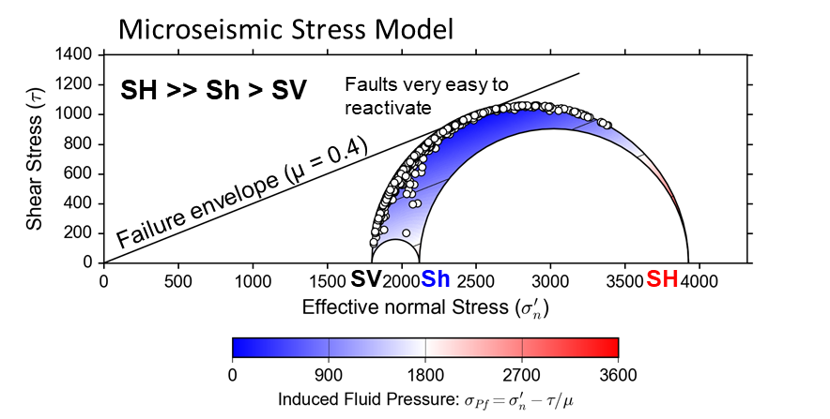

Sonic Log versus Microseismic Stress Models

Slide 8
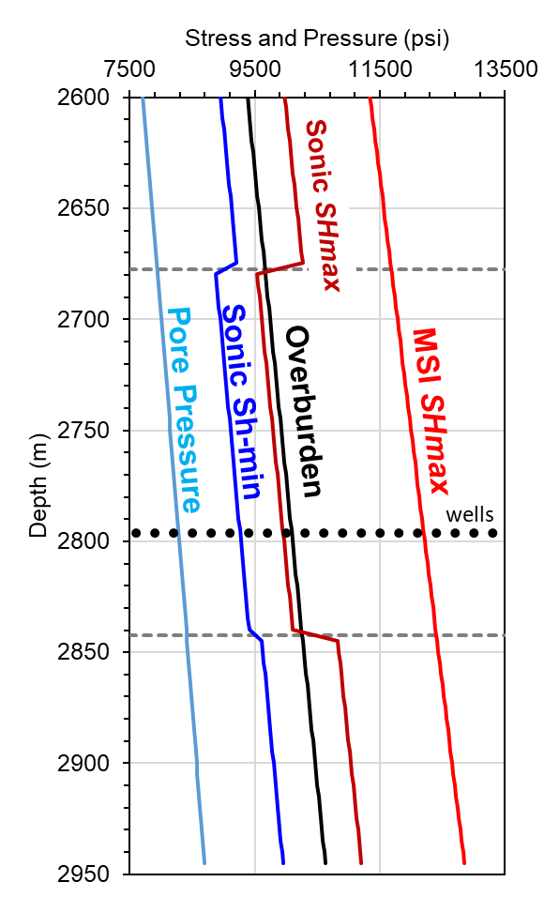

Sonic Log versus Microseismic Stress Models
MSI SHmin

Slide 9
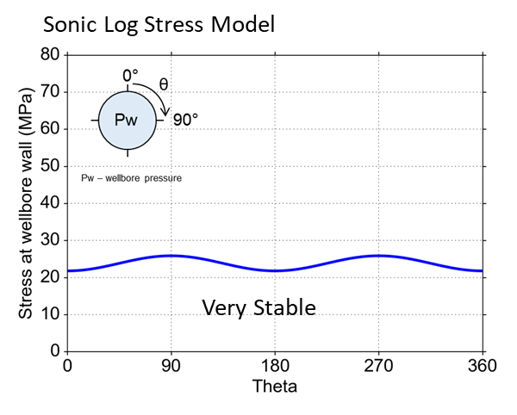
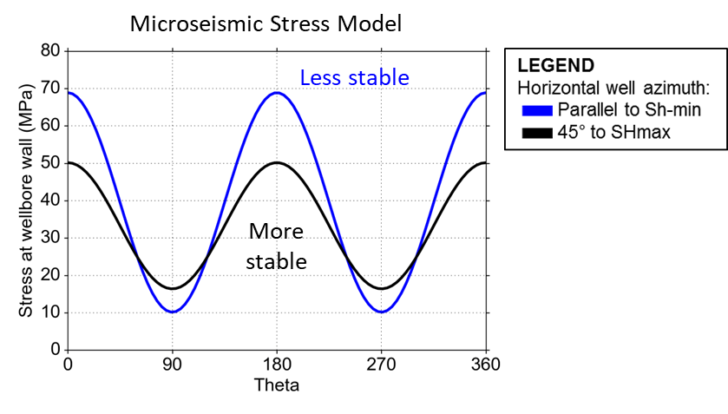

Sonic Log versus Microseismic Stress Models

Slide 10
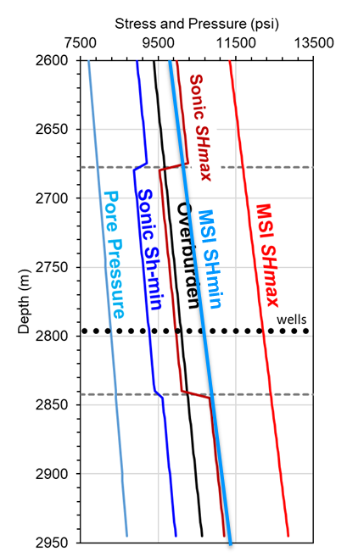

Summary
Microseismic focal mechanisms are very sensitive to in situ stress and can be used to quantify the tectonic stress field
Equations used to derive stress values from sonic logs appear to fail in highly compressive stress fields (i.e. SHmax is the max principal stress)

